Slide 1
EMPLOYEE DATA ANALYSIS USING EXCEL
STUDENT NAME: S.Sivasurya
REGISTER NO : 312200333
DEPARTMENT : Commerce
COLLEGE : S.I.V.E.T College

Slide 2
PROJECT TITLE
Employee Performance Analysis
Using Excel

Slide 3

AGENDA
Problem Statement
Project Overview
End Users
Our Solution and Proposition
Dataset Description
Modelling Approach
Results and Discussion
Conclusion
3/21/2024 Annual Review

Slide 4

PROBLEM STATEMENT
To assess and improve employee performance within the organization by analyzing performance data using Microsoft Excel. This analysis will help identify top performers, areas for improvement, and trends that can inform management decisions and training programs.

Slide 5

PROJECT OVERVIEW
The Employee Performance Analysis project aims to use Microsoft Excel to evaluate and enhance employee performance by analyzing various metrics such as sales figures, project completion rates, and customer satisfaction scores. The project involves collecting, cleaning, and organizing performance data to facilitate accurate analysis. Key deliverables include visualizations of performance trends, a detailed report with actionable insights, and recommendations for improving performance management. The analysis will help identify top performers, areas for improvement, and inform targeted interventions. The project will be completed within six weeks, with a focus on data accuracy, clear reporting, and practical recommendations for management.

Slide 6
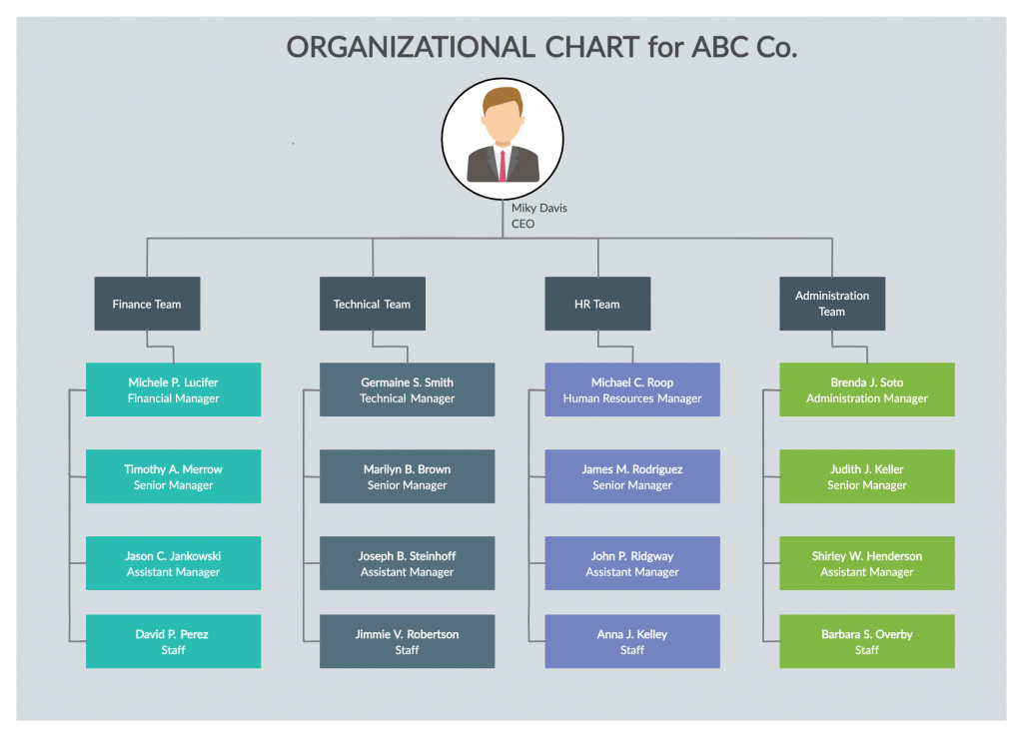

WHO ARE THE END USERS?

Slide 7

OUR SOLUTION AND ITS VALUE PROPOSITION
Conditional Formatting: Missing
Filter: Remove
Formula: Performance
Pivot: Summary
Graph: Data Visualization

Slide 8
DATA DESCRIPTION
Employee: Kaggle
26 features
9features
Employee ID: Numerical Values
Name: Text
Employee Type
Performance Level
Gender: Male And Female
Employee Rating: Numerical Values

Slide 9

THE "WOW" IN OUR SOLUTION
=IF(Z9>=5,"VERY HIGH",Z9>=4,"HIGH",Z9>=3,"MED",TRUE,"LOW”)
3/21/2024 Annual Review
9

Slide 10
MODELLING
Data Collection
Gather data from various sources such as performance reviews, KPIs, attendance records, and employee surveys.
Data Preparation
Ensure that data is accurate and complete. Address any inconsistencies or missing values.
Combine data from different sources to get a comprehensive view of performance.
Visualization and Reporting
Create interactive dashboards to visualize performance metrics and trends.
Generate detailed reports highlighting key insights, trends, and recommendations.
Analysis and Interpretation
Look for patterns in the data that might indicate high or low performance.
Compare performance across different teams, departments, or time periods.
10

Slide 11
RESULTS
11

Slide 12
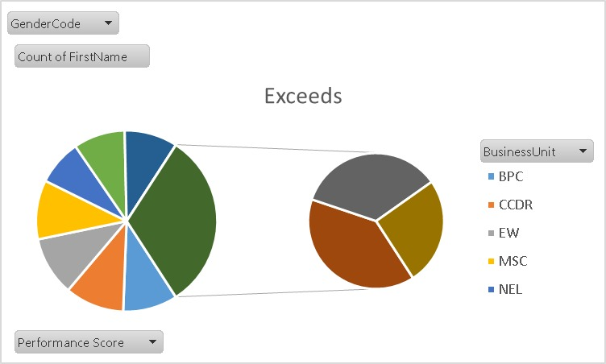

Slide 13
CONCULSION
Employee performance analysis reveals several key insights. First, there are notable trends indicating improved performance in certain departments due to recent initiatives. High performers consistently excel due to specific skills and practices, which should be recognized and shared. Conversely, some teams or individuals show declining performance, suggesting a need for targeted development. Skill gaps and resource limitations are identified as significant factors affecting performance.

